Slide 1

WEB INTERFACE FOR PREDICTING MULTIPLE DISEASES
21BIO211 IBS-4
TEAM 4
CH.EN.U4AIE21107 – Aparna S
CH.EN.U4AIE21113 – G V Rohan
CH.EN.U4AIE21115 – Harshitha M
CH.EN.U4AIE21122 – K Saiteja
CH.EN.U4AIE21125 – M Sravani

Slide 2
Agenda
Problem Statement
Isn’t it very difficult for doctors to analyze X-ray images and MRI images of patients every time? Doctors will face many challenges while analyzing the images of X-ray and MRI images. Some of the challenges are
Poor Image Quality
Time Constraints

Slide 3
Introduction
INTRODUCTION
PNEUMONIA
Image Dataset
Lung infection
Detected from X-Ray image given by the user.
CNN Model of Machine learning
HEART DISEASE
CSV Dataset containing target and predictor feature.
Detected based on the attributes like FBS, heart rate, chest pain, RBP etc.
Random Forest, Gradient Boosting, Logistic regression, SVM, KNN, Decision Tree.

Slide 4
Introduction
INTRODUCTION
MALARIA
Image Dataset
Blood smear images.
Detected from images of blood samples
CNN model of machine learning
DIABETES
CSV Dataset
Detected based on the attributes like BMI, BP, Insulin level, Skin Thickness
Random Forest, Gradient Boosting, Logistic regression, SVM, KNN, Decision Tree.

Slide 5
Objectives
The main objective of this project is to create web interface for predicting multiple diseases.
The goal of this design is to find the whether the patient is suffering from diseases like Pneumonia, Heart disease, malaria and diabetes.
In our project, we are machine learning models like CNN (Convolutional Neural Network), Random Forest (RF) to predict the diseases. These machine learning models are deployed with Stream lit – an open-source Python framework to build web apps.

Slide 6
Existing Works
Existing Works
Author Name | Algorithms & Methods Used | Description | Remarks
Mariia Mazorchuck Viktoriia Dobriak Dmytro Chumachenko | Decision tree, logistic regression Flak framework and python programming language | Web application development for tasks prediction in medical domain | This paper was published in the year 2018.This paper focuses on web applications for development of clinical diagnosis of diseases based on observation of patients.
Harish Rajora, Narinder Singh Punn Sanjay Kumar | KNN, Random forest and naïve bayes classification and an ensemble voting algorithm | Web base disease prediction and recommender system | This was published in the year 2021. This paper focuses on web-application based disease prediction system that utilizes ml techniques on datasets retrived from NCDC.
S.Sreejith, S.Rahul, R.C.Jisha | Random forest Recursive Feature Elimination(RFE) | A real time patient monitoring system for heart disease prediction using random forest algorithm | This paper was published in the year 2015. It is a remote patient monitering system.
Ipek Balikci Cemil colak | KNN, Decision trees, Support Vector machines, XG Boost methods | Development of a python based classification web interface for independent datasets | This paper was published in the year 2022. It uses cancer dataset.

Slide 7
Existing Works
Existing Works
Author Name | Algorithms & Methods Used | Description | Remarks
Cohen, J. P., Bertin, P., & Frappier, V. | Decision tree, logistic regression Flak framework and python programming language | A Web based chest X-Ray Disease Predictor | This paper was published in the year 2020. For diagnosis, the image data is provided and gets classified. The web interface runs locally without sending data to the device. Scalabitlity is extended up to million users. Dataset: 7 largest radiological public datasets.
Phil Hyoun Lee, Hagit Shatkay, F-SNP: computationally predicted functional SNPs for disease association studies, | KNN, Random forest and naïve bayes classification and an ensemble voting algorithm | F-SNP computationally predicted SNPs for disease | This paper was published in the year 2007. This system combines databases and bioinformatics tools. Further finds the impact of Single Nucleotide Polymorphism on humans.
W. N. W. M. Afifi, I. F. Warsito, M. Sayahkarajy and E. Supriyanto | Random forest Recursive Feature Elimination(RFE) | A real time patient monitoring system for heart disease prediction using random forest algorithm | This paper was published in the year 2018. The existing models deal with predicting the stroke risk factor in the patient and reduce the chances of ICU admission of patients.
Chari, K. K., M. Chinna Babu, and S. Kodati. | KNN, Decision trees, Support Vector machines, XG Boost methods | Development of a python based classification web interface for independent datasets | This paper was published in the year 2022. It uses cancer dataset.

Slide 8
DATA SETS
Pneumonia
To predict pneumonia, we used “Chest X-ray images (Pneumonia)” from Kaggle. This dataset consists of 5863 X-ray images (JPEG) and has two categories: Pneumonia and Normal. These images were collected from pediatric patients of one to five years old.
Heart Disease
To predict heart disease, we used “Heart Disease Data Set” from University of California, Irvine Machine Learning. It has 76 attributes including predicted attribute
Malaria
To predict malaria, we used "Malaria Screener datasheet” from National Library of Medicine. This dataset consists of 27,558 images (JPEG) and has two categories: Infected and Uninfected.
Diabetes
To predict diabetes, we used “Diabetes dataset” from University of California, Irvine Machine Learning. It has 8 predictor features with one target feature. Pregnancies, Skin thickness, BMI, Age, Glucose level, Pedigree are some of the attributes used.

Slide 9
Proposed Algorithm
Workflow
Data Collection
Data preprocessing
Data labelling
Splitting data
Selecting data
Selecting model architecture
Training model
Evaluating model
Testing model
Deploying model
Web interface

Slide 10
Implementation Details
Implementation
Relevant data is collected from the user.
Data is cleaned by removing missing values, handling outliers, and normalizing the data.
The most important features contributing to the prediction are identified.
Machine learning models are chosen according to the disease that have to be predicted.

Slide 11
Implementation Details
Implementation
5. The model is trained based on the data, using a portion of the data for training and the remaining data for testing the model's performance.​
6. The performance of the model is evaluated using metrics such as accuracy and F1 score.​​
7. The model is deployed with Stream lit- an open-source python framework where it can be used for disease prediction.​

Slide 12
Proposed Architecture
Machine learning Models
1. Convolutional Neural Networks (CNNs): CNNs use a series of convolutional layers to learn features from images and classify them into different categories.
2. Random Forest: To combines multiple decision trees to create a more accurate and robust model. Random Forest models can be used for classification and regression tasks .
3. Support Vector Machine (SVM): A type of supervised learning algorithm that is used for classification and regression tasks. SVMs are often used in image classification, text classification, and bioinformatics applications.
4. Logistic Regression: A type of regression algorithm used for binary classification tasks. It's commonly used for predicting binary outcomes, such as whether a patient will develop a disease or not.

Slide 13
Machine learning Models
5. Decision Tree: A type of supervised learning algorithm used for classification and regression tasks. They are easy to interpret and can handle both categorical and numerical data.
6. Gradient Boosting: It combines multiple weak models to create a stronger and more accurate model. Gradient Boosting algorithms use gradient descent to optimize the model and reduce the loss function.
7. XG Boost: XG Boost uses a combination of decision trees and gradient boosting to create a powerful and accurate model.
8. K-Nearest Neighbor (KNN): KNN models classify data based on the k nearest neighbors in the training set. It's often used for image recognition, text classification, and recommendation systems.

Slide 14
Implementation Details
System Analysis
Functional Requirement
The system should allow the user to upload the necessary image as the input according to the machine learning model and predict the output should be displayed.
Non- Functional Requirement
The website should be:
User-friendly
Reliable
Scalable
Compatible

Slide 15
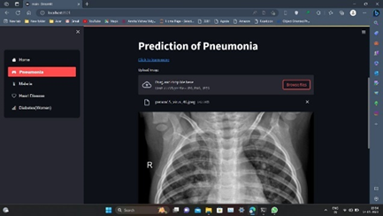
Implementation Details
PREDICTION OF PNEUMONIA
It is caused by bacteria, fungi, or viruses in the lungs.
The formation of mucus in the lungs causes symptoms like cough, fever, breathing problems, and chest pain.
This disease can be predicted through Chest X-ray, Blood tests, CT scan and physical examination.
In our model, we train the datasets of X-ray images of pneumonia using CNN.
This model helps to predict the risk factor in patients.
PREDICTION OF PNEUMONIA

Slide 16
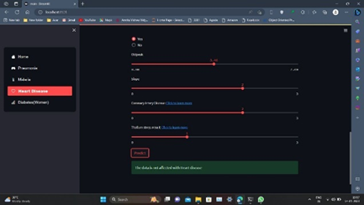
Implementation Details
Prediction of Heart diseases
The major factors that develop the maximum chance of heart disease are Blood pressure, hereditary, maximum percentage of cholesterol, and obesity.
Detection and prediction of heart disease is implemented on Random Forest which gives the best accurate results out of all algorithms.
Heart disease can be predicted through various diagnostic tests such as Blood tests, ECG, cardiac catheterization, and stress tests.
PREDICTION OF HEART DISEASES

Slide 17
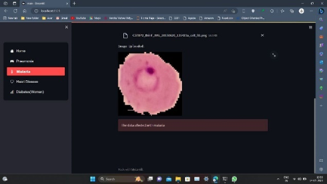
Implementation Details
Prediction of Malaria
The major factors that affect malaria are environmental factors which cause the rapid growth of mosquitoes which causes Malaria.
Convolutional Neural Networks (CNN) predicts the results most accurately in analyzing the datasets.
PREDICTION OF MALARIA

Slide 18
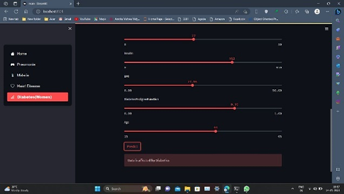
Implementation Details
Prediction of Diabetes
Women easily get infected with diseases in comparison with men because of various factors some of them are family history of diabetes, pregnancy, obesity, lack of physical activity in some women, and high blood pressure.
This model is developed based on the machine learning algorithms like Random Forest, SVM, Decision Tree, Gradient Boosting, XGBoost, Logistic Regression by retrieving BMI (Body Mass Index), Insulin, Glucose level, BP (Blood Pressure) datasets from UCI to get the best results with maximum accuracy.
PREDICTION OF DIABETES

Slide 19

Implementation Details
TOOLS/TECHNOLOGIES USED
TOOLS AND THEIR PURPOSES
Stream lit To deploy machine learning model into web interface.
Back-End Python

Slide 20
USE CASES
Predicting diseases directly from X-Ray and MRI Images has several use cases in the field of medical diagnosis and treatment:
Early disease detection – It aids in the detection of diseases at an early stage.
Reduction in health care costs – It reduce cost by eliminating unnecessary tests.
Patient Education- It helps to know about patient condition and treatments available.
Treatment Planning: It enables doctors to determine the best treatment for the patients by improving patient outcomes and reducing the risk of complications.

Slide 21
Implementation Details
RESULT
Accuracy table for Heart disease
S.No | Algorithm | Testing accuracy (%) | Training accuracy (%)
1 | Logistic Regression | 85.49 | 88.31
2 | KNearestNeighbors | 87.86 | 86.03
3 | SVM | 71.04 | 71.45
4 | Decision Tree | 100 | 96
5 | Random Forest | 98.88 | 98.05
6 | Gradient Boosting | 98.60 | 97.72
7 | XGBoost | 97.907 | 97.07

Slide 22
Implementation Details
RESULT
Accuracy table for Diabetes
S.No | Algorithm | Testing accuracy (%) | Training accuracy (%)
1 | Logistic Regression | 84.02 | 88.15
2 | KNearestNeighbors | 86.6 | 83.33
3 | SVM | 89.47 | 84.42
4 | Decision Tree | 86.54 | 89.47
5 | Random Forest | 98.30 | 92.25
6 | Gradient Boosting | 100 | 89.03
7 | XGBoost | 98.49 | 97.5

Slide 23
Implementation Details
RESULT
Accuracy table for Malaria
S. No | Algorithm | Accuracy
1. | CNN | 90.05
2. | SVM | 50

Slide 24
Implementation Details
RESULT
Accuracy table for Pneumonia
S. No | Algorithm | Accuracy
1 | CNN | 95.2
2 | SVM | 50

Slide 25
Conclusion
Conclusion
In this project, the trained machine learning models are deployed in a Stream lit- a python framework to make it user-friendly web interface.
The machine learning algorithms used are Logistic Regression, K-Nearest Neighbour, Support Vector Machine, Decision tree, Convolutional Neural Network and Random Forest.
The web application for multiple disease predictor help physicians to make more accurate decisions regarding patient health. It can also help professionals to reduce the workload by automating the process of disease prediction.

Slide 26
Conclusion
Future Scope
Subsequently, we can extend this project by appending more diseases that can be predicted by machine learning and deep learning algorithms.
Also, we can improve scalability of the web interface.
Changing the local host to the global host.

Slide 27
Contribution :
Roll no | Name | Contribution in project | Contribution in report
21107 | Aparna | Pneumonia and backend python of streamlit | Introduction and problem statement Methodology(pneumonia disease)
21113 | G.V.Rohan | Malaria | Proposed solution and Methodology(malria disease)
21115 | M.Harshitha | Machine learning algorithms and collection of dataset | Literature survey And Methodology(heart disease)
21122 | K.saiteja | Machine learning algorithms and backend python ofstreamlit | Algorithms of machine learning and deeplearning Result and conclusion
21125 | M.Sravani | Machine learning algorithms and data set collection | System analysis and Methodology(diabetes disease)

Slide 28
THANK YOU

